Slide 1
ROUND 1 — AI CONSULTING PITCH
The Property Management System - Pitch
A property-management module for private landlords, pitched to Chleo — CEO of an existing property listing platform who isn't sure what “the AI” actually does.
Prepared for the Round 1 teaching-staff presentation
Property Ledger
01 / 14

Slide 2
02
THE SCENARIO
Chleo just finished asking the question every AI pitch dreads.
She runs a property listing platform with around 0.5M MAU and 150K Landlords . She's heard the AI hype, and she's scared it isn't transparent — she doesn't know what “the AI” is, or how she'd explain it to her own team if something went wrong.
— She isn't asking for a moonshot. She's asking for something she can look at and understand.
— This pitch is built to answer her fear directly, not talk around it — every claim is cited, every limit is stated out loud.
WHAT THIS PITCH IS NOT
A black box that promises to handle everything
It's one narrow, honest capability — see slide 05.
Property Ledger
02 / 14

Slide 3
03
WHY NOW
Private landlords in Germany aren't a shrinking niche.
PRIVATE-LANDLORD HOUSEHOLDS, DE
3M → 5M+
6% of the Total population, 2010→2022 — a growing trend.
GERMANY IS MAJORITY-RENTER
53%
of households rent (Zensus 2022) — the only EU country where more rent than own.
FOREIGN POPULATION, DE
10.9M → 14.1M
+28.9%, 2018→2025 — skews toward investing and renting (eg. Asia, India & USA).
Foreign population growth is the sole driver of Germany’s overall population growth.
REAL-ESTATE AI HIRING, 2025
+93.5%
YoY, 2nd-fastest of any sector tracked — still early-stage.
SOURCE: IW Köln “Private Vermieter in Deutschland” (SOEP v39+Zensus) · Destatis Zensus 2022/AZR · Stanford HAI AI Index 2026
Property Ledger
03 / 14

Slide 4
04
WHO THE CUSTOMER REALLY IS
Not a professional investor — someone with one apartment and a spreadsheet they don't trust.
OWN AT MOST 2 PROPERTIES
~75% (approx 3.75 M)
of private landlords (IW Köln Vermieterreport 2026, n=1,002) — and the 1-property share is rising: 55%→58%, 2024→2026.
Currently they have to spend approx 180 Euros/Year on other solutions in market to manage it.
SOURCE: IW Köln, Deutschland.Immobilien Vermieterreport 2026
Property Ledger
04 / 14

Slide 5
05
THE PITCH
Your landlords are already your users. Give them the module they're missing.
Chleo's platform already has private landlords as listing-side users. This isn't a new market — it's a second product for a customer she already has.
01
Upload
Landlord uploads a rent receipt, EMI statement, Nebenkosten invoice, or lease.
02
AI drafts
The model extracts fields and rates its own confidence — never guesses silently.
03
Landlord confirms
Nothing saves until a human reviews it. Low confidence gets flagged, not hidden.
04
Dashboard updates
Portfolio profit & loss, occupancy, and market comps — always current.
Additional features (scoping for Round 2)
Direct Bank Connections for checking incoming rent, reminders to tenants (nice to have) for automatic pull of statements
Manage the costs and profits (Must have)
Automated Rental Contract Generation (Could have)
Tax Savings Advisor Bot (Should have)
Tenants complaints management (Could have)
Property Ledger
05 / 14

Slide 6
06
Pilot - Answering your fear
“AI isn't transparent” — here's what we built so that objection doesn't hold.
— AI Index 2026's MortgageTax benchmark: even frontier models don't reliably exceed 69.4% accuracy on real financial documents. We designed around that number, not a marketing claim.
— Every extraction is a draft, never a save. The confidence threshold is set at that same 0.70 ceiling — not a round number picked for looks.
— Every model call is traced in LangSmith — what it saw, what it returned, why it was or wasn't flagged. Inspectable, not a black box.
SAMPLE: CLEAN DOCUMENT
confidence 0.98
CONFIRMED
SAMPLE: GARBLED SCAN
confidence 0.50
NEEDS REVIEW
SOURCE: AI Index Report 2026 §2.5 (MortgageTax) · langsmith/run_monitoring_sample.py, actually executed
Property Ledger
06 / 14

Slide 7
07
RISKS, NAMED — NOT BURIED
What could go wrong, and where we've deliberately drawn the line.
TECHNICAL
Document extraction tops out around 70% accuracy on real financial documents — designed around with mandatory human review, not hidden.
Bank API connections can be unstable(costs also not taken into considerations) - Provide options to upload the bank statement manually, once in a month.
REGULATORY
Uploaded documents are sensitive financial data — a real GDPR surface (legal basis, DPIA, third-party processor) - Risk is low as the system will be GDPR complaint
Customer ADOPTION
Our own customer is price-sensitive and low-tech-sophistication — But keeping the costs low and providing value will drive adoption
Property Ledger
09 / 14

Slide 8
08
MONETIZATION
Would €2 a month even be worth charging?
Assume 150,000 new rental properties enter the German market each year. Private-landlord households grew by +1.8M over 2010–2022 (slide 03), which averages to almost 150,000/year.
Market capture | Landlords | Revenue / month | Revenue / year | What Landlords currently Paying per year(eg. Immoscout)
5% | 7,500 | €15,000 | €180,000 | €0.99M
10% | 15,000 | €30,000 | €360,000 | €1.8M
25% | 37,500 | €75,000 | €900,000 | €4.9M
100% (ceiling) | 150,000 | €300,000 | €3,6M | €20M
SOURCE: IW Köln SOEP v39+Zensus (see slide 03) · 150,000/year is illustrative market sizing, not a verified external forecast
Property Ledger
13 / 14

Slide 9

09
UNIT ECONOMICS
The math holds even at the lowest defensible price.
VARIABLE COST PER LANDLORD
~€0.02–0.04/mo
AI extraction cost, blended — from cost_estimation/cost_analysis.md.
BREAKEVEN
~1,340 landlords
Under 1% of the 150,000/year addressable pool — inside the pilot scale already discussed.
FIXED MONTHLY COST
~€2,665–2,685
Tableau+n8n tooling (~€70–90) plus 0.1 FTE maintenance at the same €150/hr rate already used in the cost estimate.
Landlords | Revenue | Cost | Margin
2,000 (pilot) | €4,000/mo | €2,765/mo | +31%
15,000 (10%) | €30,000/mo | €3,285/mo | +89%
75,000 (50%) | €150,000/mo | €4,500/mo | +97%
Even the pilot scale already discussed elsewhere in this deck is profitable at €2/month.
SOURCE: cost_estimation/cost_analysis.md — unit costs cited to public pricing; breakeven/margin computed here, not previously published
Property Ledger
14 / 14

Slide 10
10
PROJECT PLAN (POC and then 3 month to Production)
What ships when — priority follows the customer, not the demo.
Scoped as a MoSCoW backlog. The order isn't about what's technically impressive — it's about what the landlord from slide 04 (small portfolio, side income, low tech-sophistication) actually needs first.
Priority | Feature | Status
Must have | Manage the costs & profits | Built - Round 1 core (extraction + dashboard); Round 2 hardens to production
Should have | Tax savings advisor bot | New - Round 2/3 candidate
Could have | Automated rental contract generation | Adjacent to lease-extraction already built - inverse direction
Could have | Tenant complaints management | Adjacent to maintenance-request tracking already prototyped
Nice to have | Direct bank connections (rent verification, tenant reminders, auto statement pull) | Already demoed end to end (Enable Banking Mock ASPSP) - lowest priority, most de-risked
Property Ledger
15 / 15

Slide 11
11
RECORDED AFTER THIS PRESENTATION
Keep or change — written down honestly, not decided in advance.
DECISION
Keep
Project Idea is good, keep the industry and company size
Use Supabase for the DB (Postgres)
Reduce the scope (bank account connections - nice to have) and use
Property Ledger
12 / 14

Slide 12
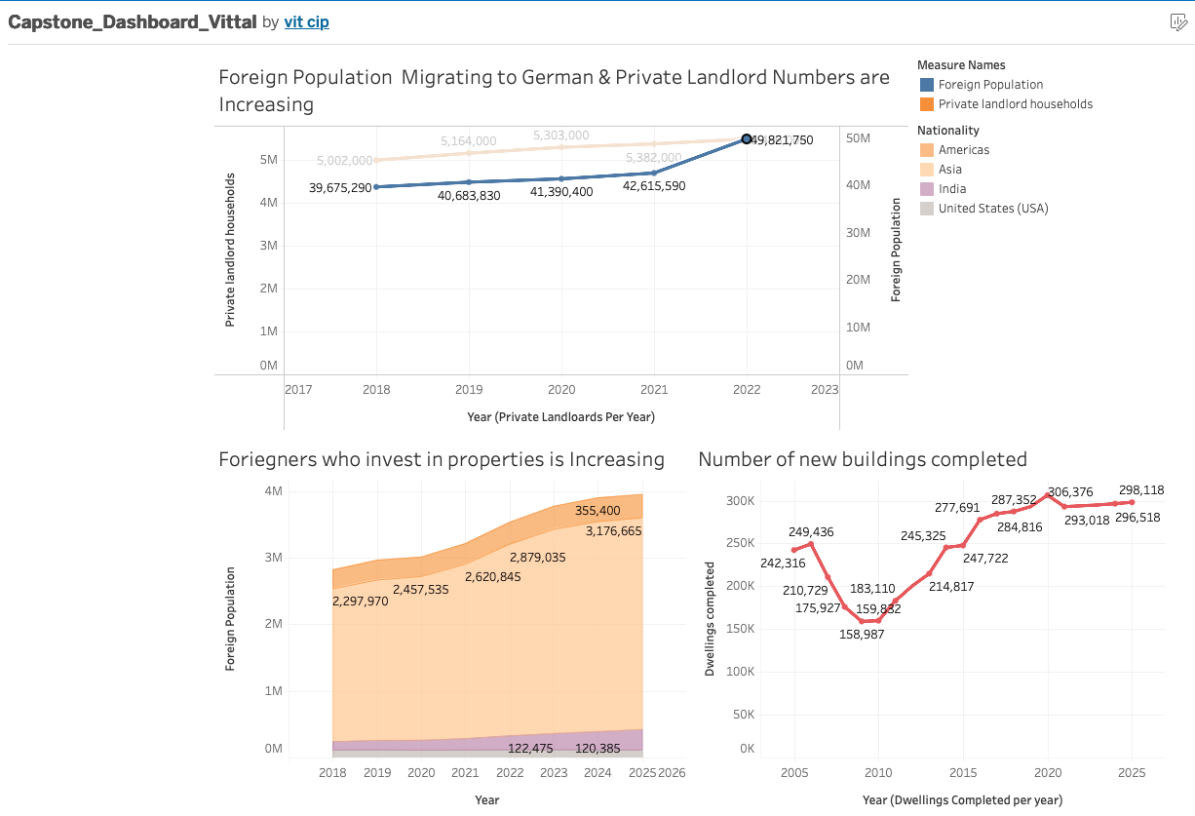
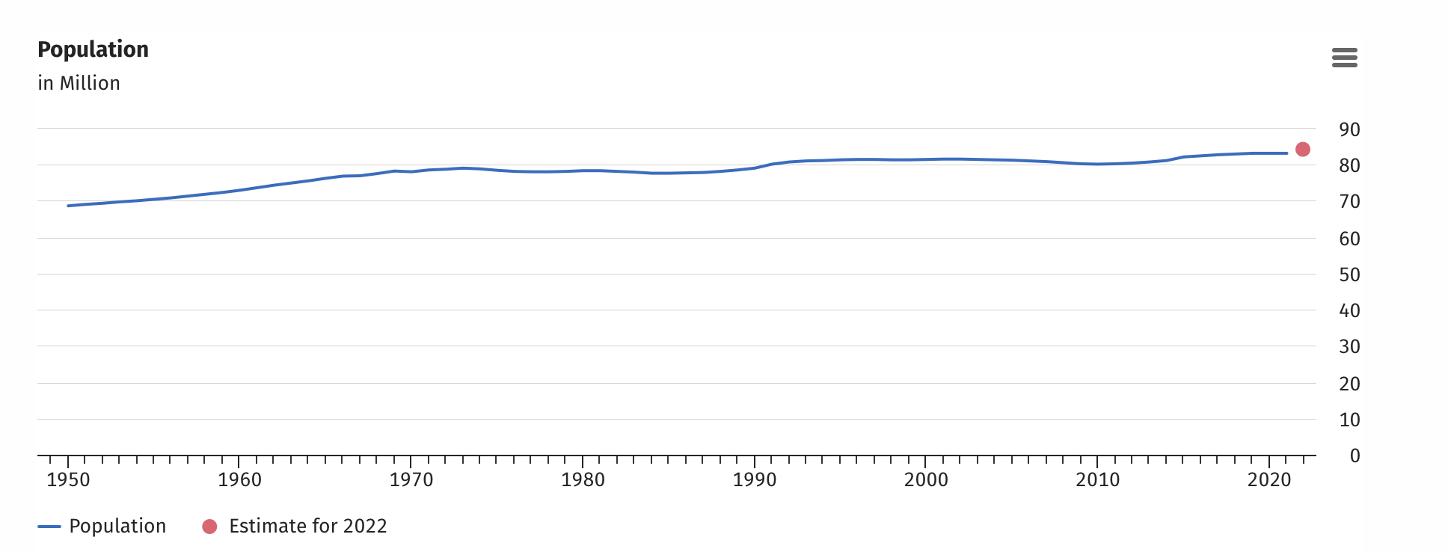
12
Appendix
Tableau Dashboard & Supporting Graphs
https://public.tableau.com/views/Capstone_Dashboard_Vittal/Dashboard1?:language=en-GB&:sid=&:redirect=auth&:display_count=n&:origin=viz_share_link
Property Ledger
12 / 14

Slide 13
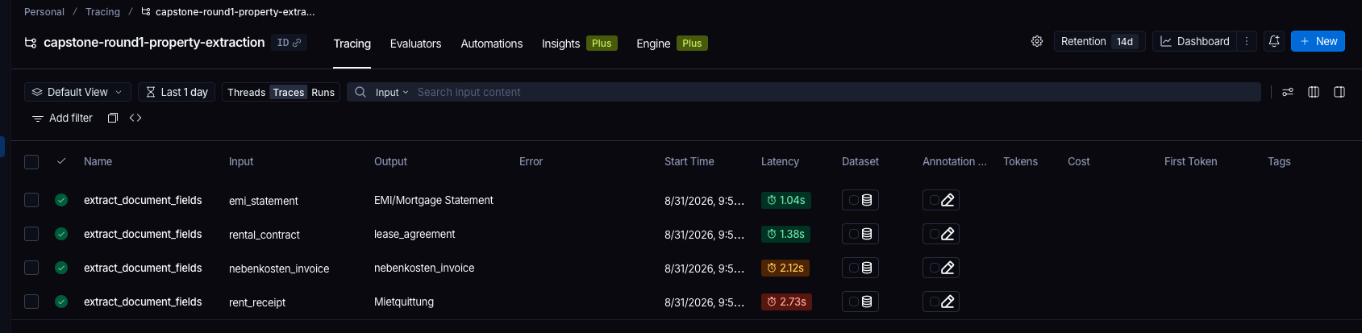
13
Langsmith Tracking
Property Ledger
12 / 14

